Slide 1
INTERACTION STYLES. Roll No: 19SW120.

Slide 2
INTERACTION STYLES
Interaction styles are primarily ways in which the user and the computer system can communicate

Slide 3
INTERACTION STYLES
Graphic-User Interface
Menu Bar Interface
Form Fill-interface
Command Line Interface
Natural Language
Question Answer Interfaces

Slide 4
Graphical User Interface
GUI (user interface) is a program of interactive visual components of computer software. The GUI displays the information that transmits information, and represents actions that the user can take. Items change color, size, or appearance when a user interacts with them

Slide 5
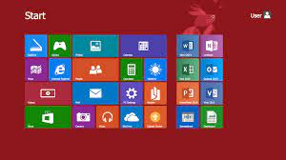
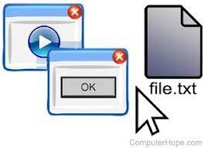
Graphical User Interface

Slide 6
Graphical User Interface
Benefits:
It is very easy to use for beginners
They enable you to easily exchange information between software using cut and paste or 'drag and drop‘
They use a lot of memory and processing power
They can be annoying to experienced users when simple tasks require several tasks.

Slide 7
Graphical User Interface
Disadvantages:
Low flexibility: only pre-planned instructions can be made
System performance cannot be modified or modified
GUIs require the maximum amount of storage space in the system
GUIs are slower than workspaces based on command lines only
It is equally difficult for developers to create an intuitive GUI
Some commands take longer to implement

Slide 8
Command line
The first style of interaction that should be used most commonly.
Command to be remembered, No suggestion is given in the command line to indicate which command is required.
Provide direct computer instructions using:
Abbreviations (e.g. ip, htttp.)
One character
Function key
The whole word
A combination of the above

Slide 9
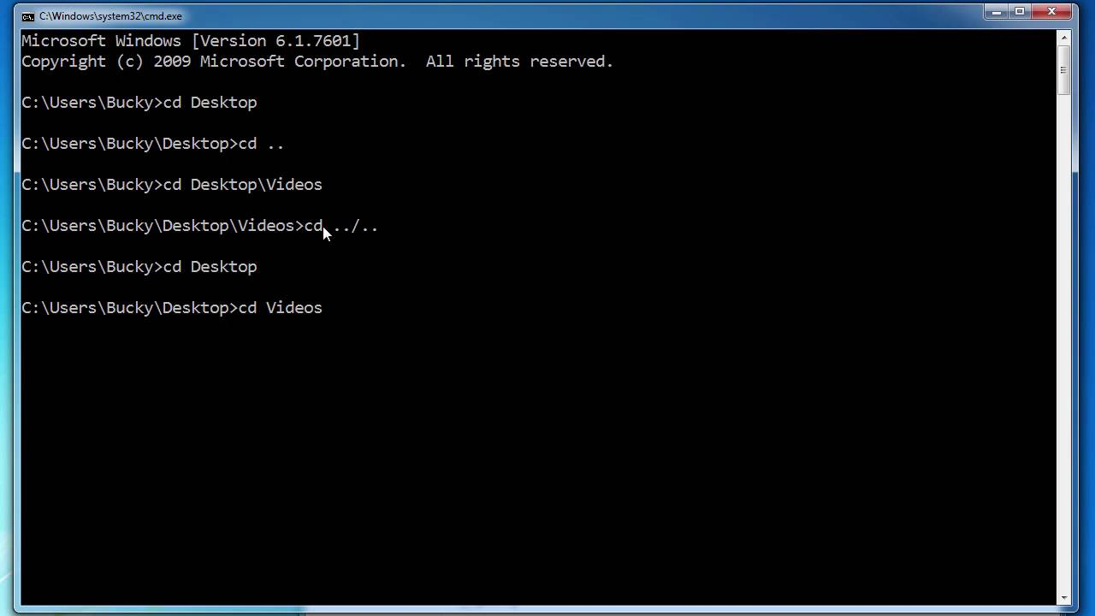
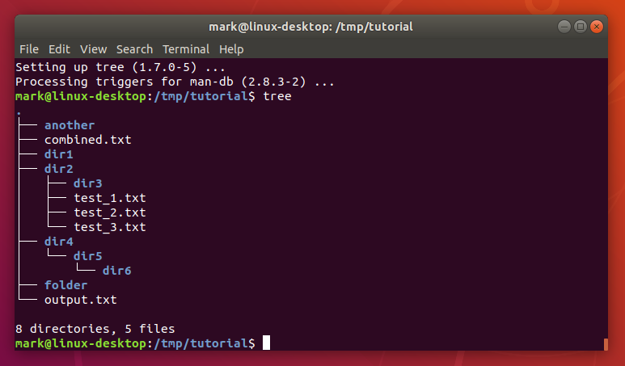
Command line

Slide 10
Command line
Benefits:
1. If you know the instructions, CLI can be much faster and more efficient than any other type of interface. It can also easily manage repetitive tasks.
2. CLI requires less memory to be used compared to other links. Nor does it spend as much time processing CPU as other interface.
3. CLI does not require Windows and a low resolution monitor can be used. That is, it requires a few resources, yet very accurate.

Slide 11
Command line
Disadvantages:
1. If you are new to programming or have never used CLI, this method can be confusing. There are also many commands that need to be read (i.e. in this Unix case, there are hundreds of commands).
2. Accuracy is very important. If there is a spelling error, the command will fail. Also, if the discipline is not properly typed, you will usually need to start over

Slide 12
Natural language
A natural language interface is a user interface in which the user and the system communicate via a natural (human) language. The user provides input as sentences via speech or some other input, and the system generates responses in the form of sentences delivered by speech, text or another suitable modality.

Slide 13

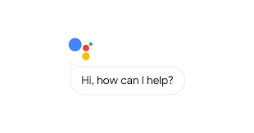
Natural language

Slide 14
Natural language
Benefits:
Users do not have to learn the syntax or principles of a particular language
Suitable for users with physical disabilities / mobility problems
It can provide safe interaction in certain areas - Example: Driving a car

Slide 15
Natural Language
Disadvantages:
Incorrect interpretation due to ambiguous or lack of clearance input.
A virtual voice connector may need training so the software can detect what the user is saying.

Slide 16
MENU BAR Interface
In menu based interfaces, the user is presented with a list of options or most time, icons, each of which is mapped to a certain functionality, another screen or a submenu.
The user chooses a option or a series of options from the given list until the desired task is performed.

Slide 17
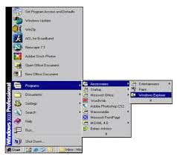
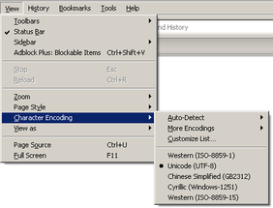
MENU BAR

Slide 18
MENU BAR Interfaces
Benefits:
1. shorten the reading curve
2. reduces the buttons
3. plan to make decisions
4. allows the use of dialogue management tools
allows easy debugging support

Slide 19
MENU BAR Interfaces
Disadvantages:
1. poses a risk of deep menu setup
2. may delay regular users
3. consumes screen real estate
4. requires a quick display level

Slide 20
Form Fill-in
Form-fill interfaces consist of onscreen forms or Web-based forms displaying fields containing data items or parameters that need to be communicated to the user.
The form often is a facsimile of a paper form already familiar to the user
Forms for display screens are set up to show what information should be input and where. Blank fields requiring information can be highlighted with inverse or flashing characters.

Slide 21
Form fill-in
Benefits:
Easy to implement
It is easy for the user to see the options available
Data verification can be used in the data entry form
It's quick to enter data or make a selection
Little or no training is required
They do not need a large amount of processing power or memory

Slide 22
Form fill-in
Disadvantage:
Only limited options are presented
Visually impaired people may have difficulty seeing text or options
Not suitable for more complex applications, for example, a tax form may contain up to 20 pages of options that need to be completed

Slide 23
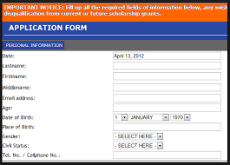
Form Fill-in

Slide 24
Question answer
In a question-and-answer interface, the computer displays a question to the user on the display. To interact, the user enters an answer (via a keyboard stroke or a mouse click), and the computer then acts on that input information in a preprogrammed manner, typically by moving to the next question.

Slide 25
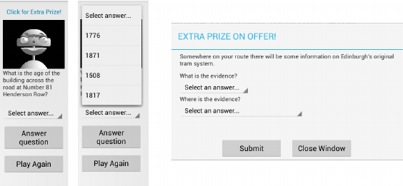
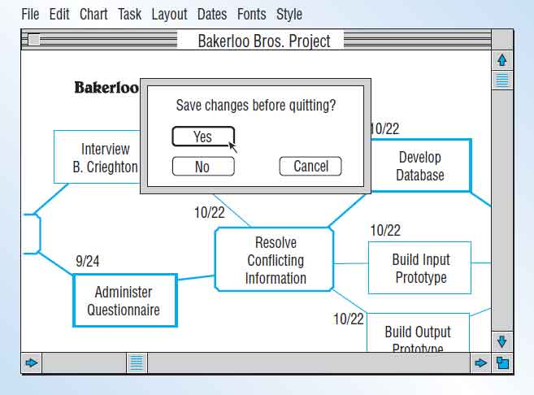
Question answer

Slide 26
Question-Answer Interface
Benefits:
Low memory needs
Ask Descriptively
Simple line asking
Easy for Learners

Slide 27
Question-Answer Interface
Disadvantages:
Requires valid input provided by the user
Needs familiarity with interaction controls

Slide 28
THANKYOU!!

